Slide 1

Project 1: Hotel Reservation Analysis with SQL
Prachi Bhandari

Slide 2
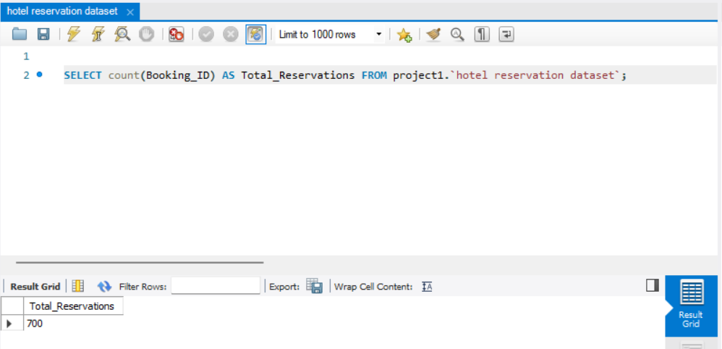
Question: What is the total number of reservations in the dataset?
Explanation: We will use the count() function to get the total number of reservations. Hence there are 700 total reservations.

Slide 3
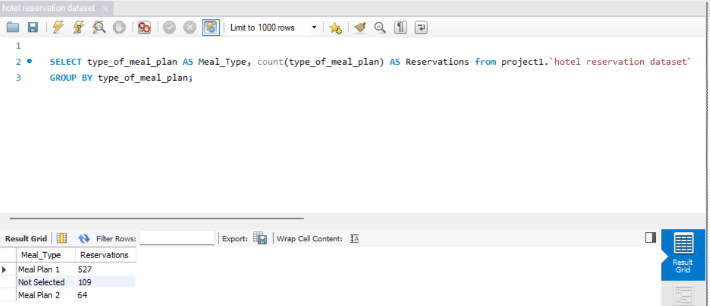
Question: Which meal plan is the most popular among guests?
Explanation: We will use the count( ) and group by( ) function to get the most popular meal plan. Hence the most popular meal plan is Meal Plan 1.

Slide 4
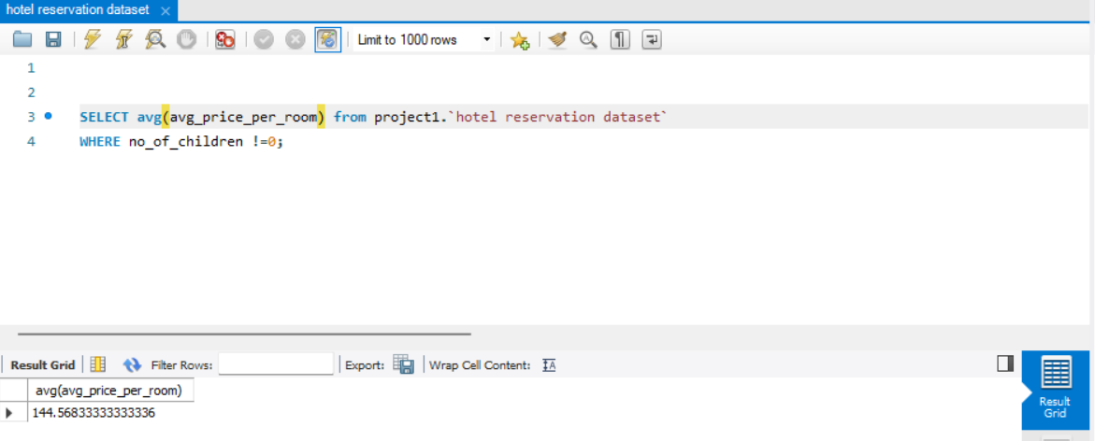
Question: What is the average price per room for reservations involving children?
Explanation: We will use the avg( ) function to get the average price per room in which children must be there. Hence the average price per room is 144.57.

Slide 5
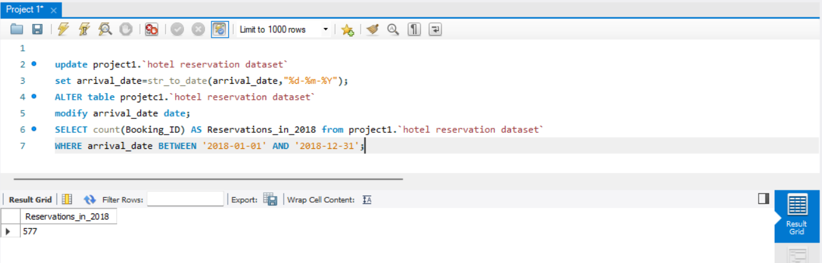
Question: How many reservations were made for the year 2018?
Explanation: In this the arrival date is not in proper format which is yyyy-mm-dd. So first we will correct the format then applied functions to get the total number of reservations in 2018 i.e., 577.

Slide 6
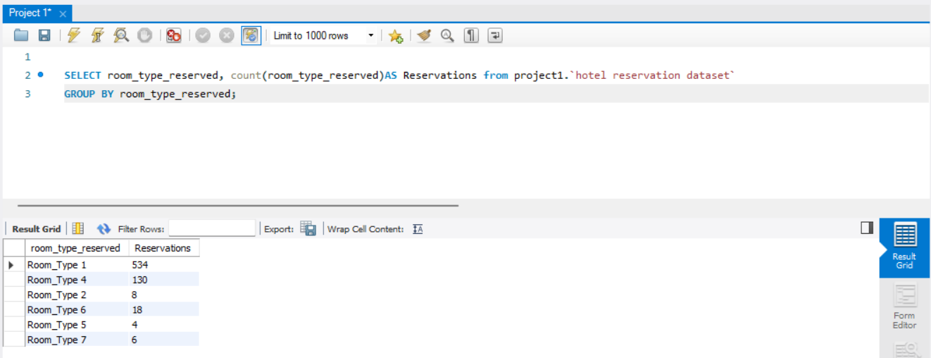
Question: What is the most commonly booked room type?
Explanation: To find out the most commonly booked room type we will use count ( ) functions. The commonly type room booked is Room Type 1

Slide 7
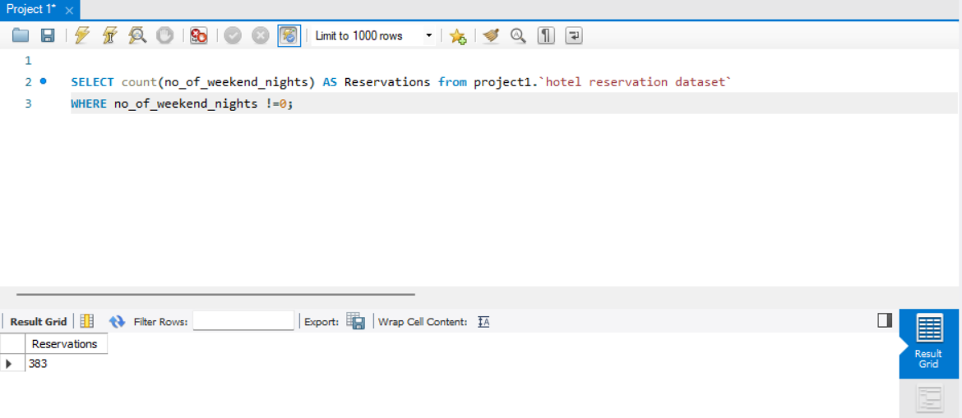
Question: How many reservations fall on weekend?
Explanation: We will use count( ) on no of weekend nights functions to find out the reservations fall on weekend. Hence the total number of weekend nights are 383.

Slide 8
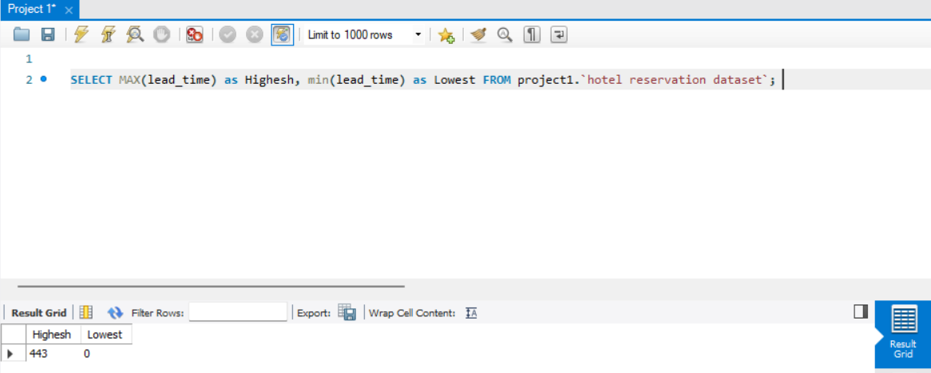
Question: What is the highest and lowest lead time for reservations?
Explanation: We will use max( ) and min ( ) functions to find the highest and lowest value. The highest value is 443 and lowest value is 0 for the lead time for reservations.

Slide 9
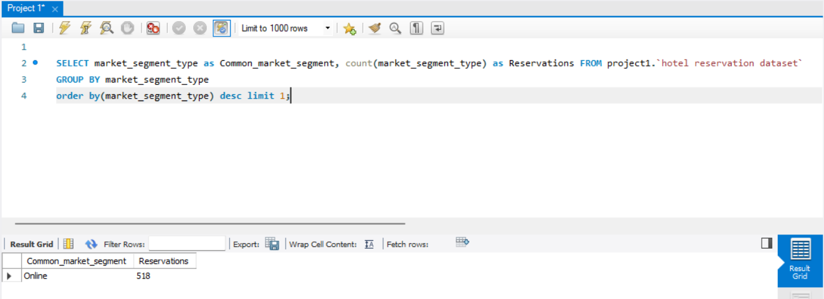
Question: What is the most common market segment type for reservations?
Explanation: The most common type is Online which have 518 reservations.

Slide 10
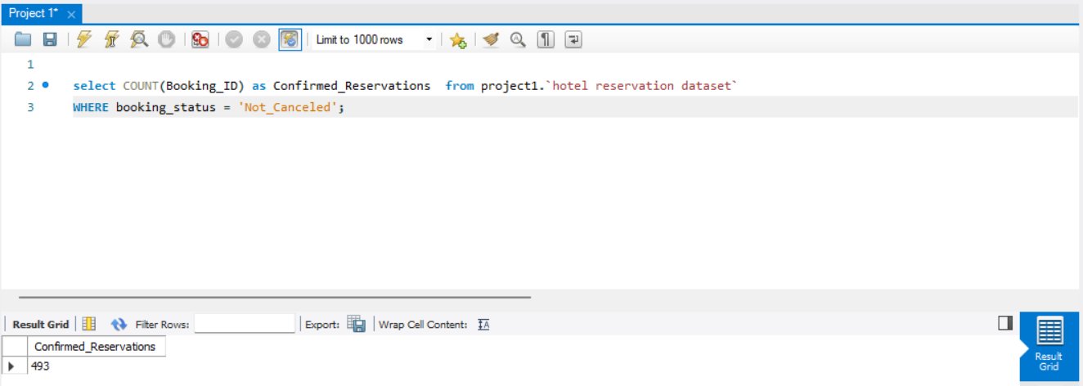
Question: How many reservations have a booking status of ‘Confirmed’?
Explanation: The reservations have a booking status confirmed is 493.

Slide 11
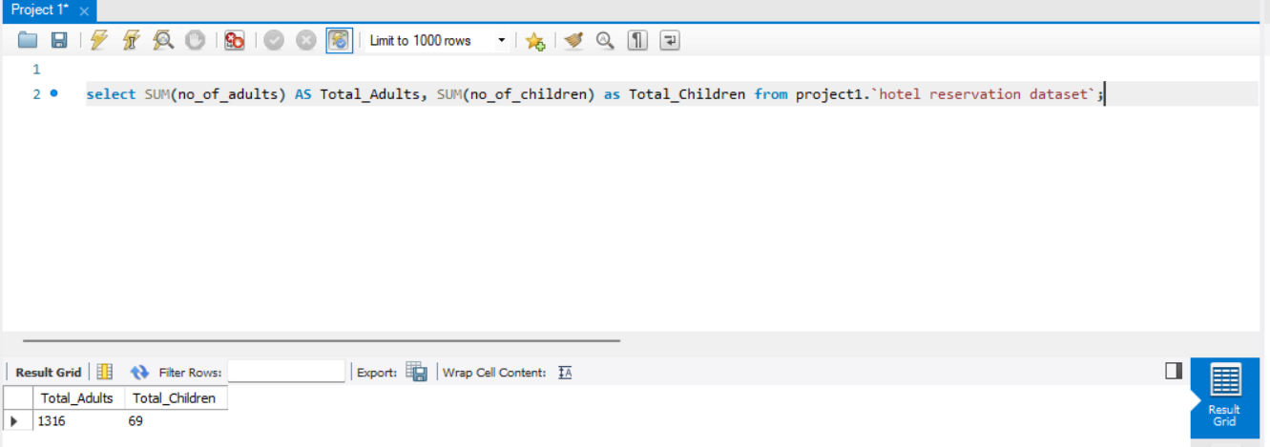
Question: What is the total numbers of adults and children across all reservations?
Explanation: We will use the sum( ) functions to find out the total numbers of adults and children across all reservations. Hence there are 1316 total adults and 69 total children in all reservations.

Slide 12
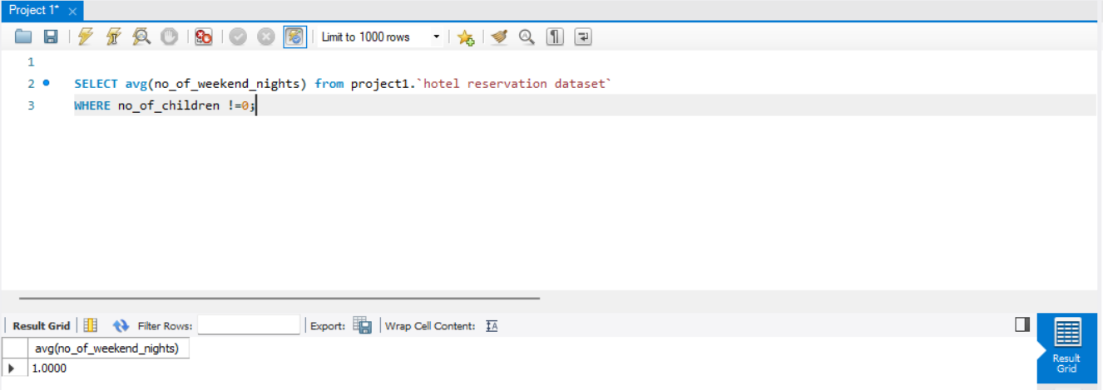
Question: What is the average numbers of weekend nights for reservations involving children?
Explanation: To find out average we will use avg( ) function. Hence the average numbers of weekend nights in which there are children is 1.

Slide 13
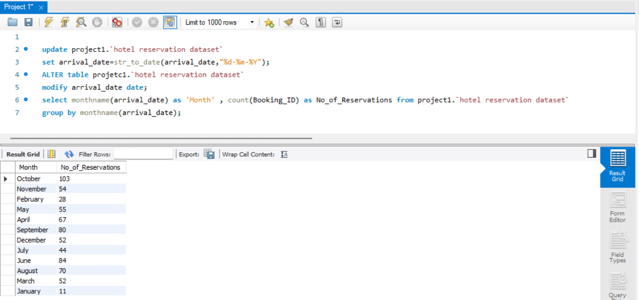
Question: How many reservations were made in each month of the year?
Explanation: Since the arrival date column is in text so first we will convert the column into date and then we will find out the reservations made in each month of the year .

Slide 14
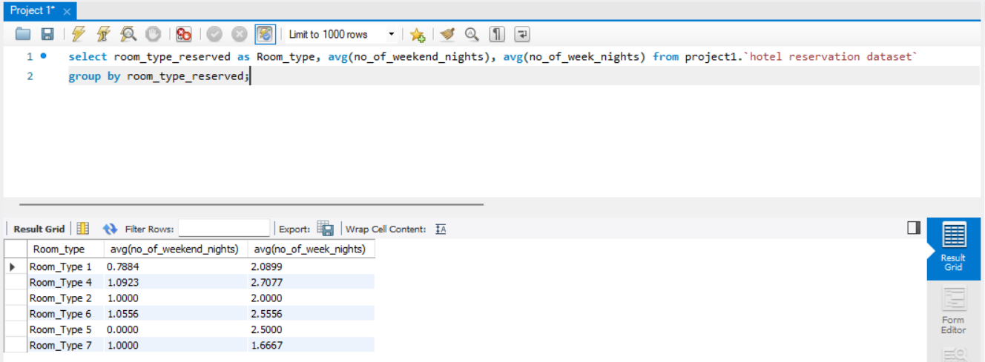
Question: What is the average number of nights(both weekend and weekdays) spent by guests for each room type?
Explanation: So in this we will average functions on both weekend and weekdays and we will use group by function on room type reserved.

Slide 15
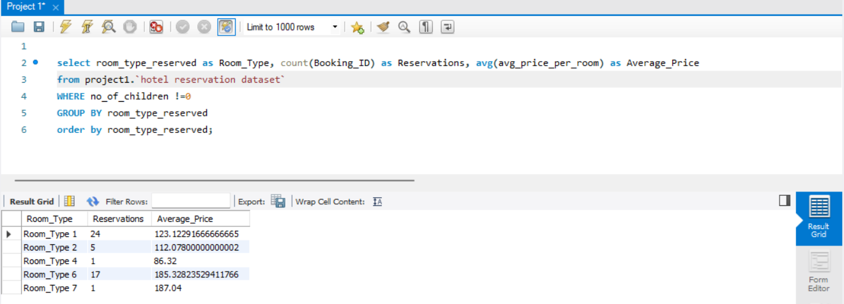
Question: For reservations involving children. What is the most common room type and what is the average price for that room type?
Explanation: The most common room type is Type 1 and its average price is Rs.123.12.

Slide 16
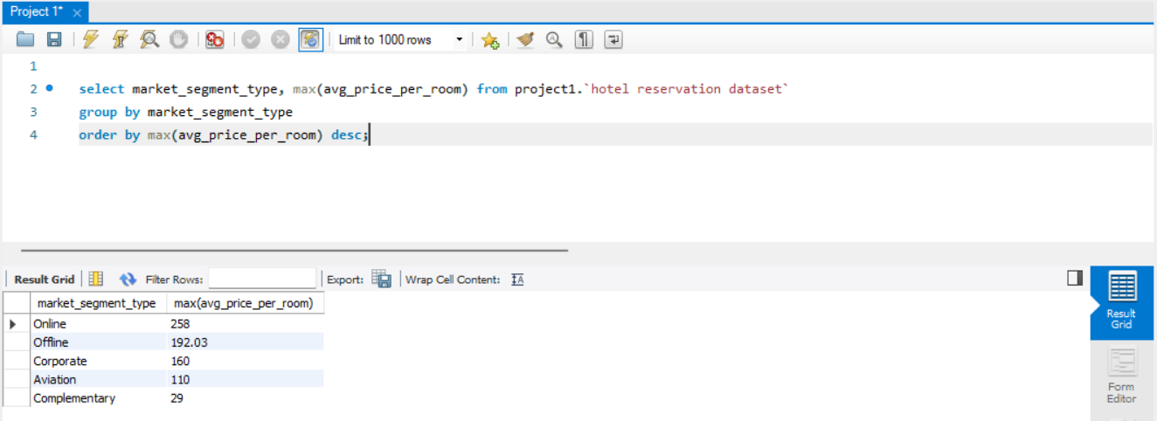
Question: Find the market segment type that generates the highest average price per room?
Explanation: The market segment type that the highest average price per room is Online and the price is Rs. 258.

Slide 17


